Slide 1
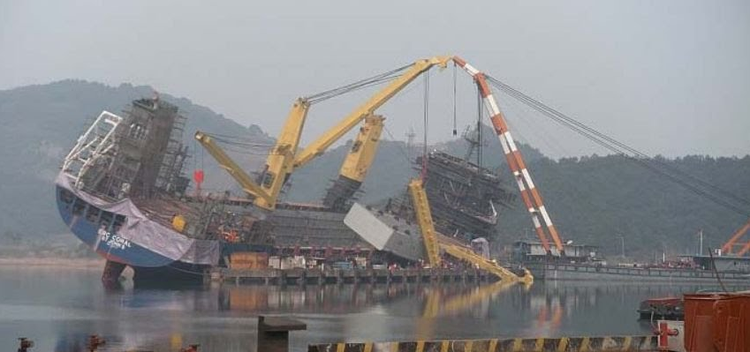
Mech 328 – Standards and Codes
Photo credit: Shipping Newsclippings (Piet Sinke) http://antipodeanmariner.blogspot.ca/2012/03/heavy-lift-accident.html
Bill Rawlings, P.Eng., MASc.
bill.rawlings@mech.ubc.ca
June 26, 2019

Slide 2
Introduction
UBC mechanical engineering graduate BASc. (2005) and MASc. (2008)
Director of Operations, Mavi Innovations since 2008
Standards Participation:
National committee member for IEC TC 114 (Marine Energy Standards) since 2008
Subject Matter Expert for development of two standards
Canadian representative to the IEC Young Professional Program 2012
Vice-chair (2014) and current co-chair (2016) of Canadian National Committee to IEC TC114

Slide 3


Today’s Objectives
Describe the difference between standards, codes, regulations, and certification
Explain why standards are important, how they are used, and some of the challenges they may present
Identify standards applicable to the microplastics ocean sampling project
https://www.wrfalp.com/chautauqua-lake-to-be-used-in-international-microplastics-study/
https://www.drkkesler.com/lab-testing-for-brain-health-and-depression/

Slide 4
Today’s Objectives
Describe the difference between standards, codes, regulations, and certification
Explain why standards are important, how they are used, and some of the challenges they may present
Identify standards applicable to the microplastics ocean sampling project
https://www.wrfalp.com/chautauqua-lake-to-be-used-in-international-microplastics-study/
https://www.drkkesler.com/lab-testing-for-brain-health-and-depression/

Slide 5
Outline
Why and from where?
Standards / Certification / Codes / Regulations
Who’s who in North America
Example standards organizations
Benefits of standards
Challenges to be aware of
How we can use them
Summary
Exercise: project-applicable standards
Notes:
Acknowledge it may get a bit dry in the middle – due to both the fact that

Slide 6
Ever read a law book?
§ 136.105 Applicability.
(a) This subchapter is applicable to all U.S.-flag towing vessels as defined in § 136.110 engaged in pushing, pulling, or hauling alongside, except -
(1) A vessel less than 26 feet (7.92 meters) in length measured from end to end over the deck (excluding the sheer), unless that vessel is pushing, pulling, or hauling a barge that is carrying oil or hazardous material in bulk;
(2) A vessel engaged in one or more of the following:
(i) Assistance towing as defined in § 136.110;
(ii) Towing recreational vessels for salvage; or
(iii) Transporting or assisting the navigation of recreational vessels within and between marinas and marina facilities, within a limited geographic area, as determined by the local Captain of the Port (COTP);
(3) A workboat operating exclusively within a worksite and performing intermittent towing within the worksite;
(4) A seagoing towing vessel of 300 gross tons or more subject to the provisions of subchapter I of this chapter;
(5) A vessel inspected under other subchapters of this chapter that may perform occasional towing;
(6) A public vessel as defined in 46 U.S.C. 2101;
(7) A vessel that has surrendered its COI and is laid up, dismantled, or otherwise out of service; and
(8) A propulsion unit used for the purpose of propelling or controlling the direction of a barge where the unit is controlled from the barge, is not normally manned, and is not utilized as an independent vessel.
(b) [Reserved]
46 CFR Chapter I, Subchapter M, Part 136: From: https://www.law.cornell.edu/cfr/text/46/136.105

Slide 7
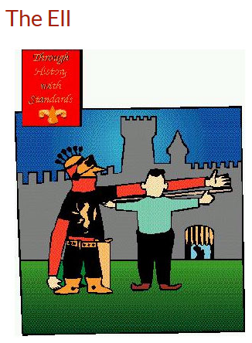
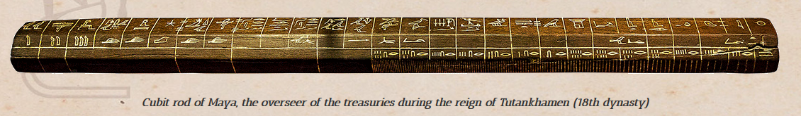
Origins of Standards
The Royal Egyptian Cubit decreed to be equal to the length of the ruling Pharaoh’s forearm from elbow to tip of middle finger(~52 cm)
1120 AD: King Henry the First of England instituted the Ell, equivalent to the length of his arm
https://www.willemwitteveen.com/the-royal-cubit/ https://www.standardslearn.org/lessons.aspx?key=26

Slide 8
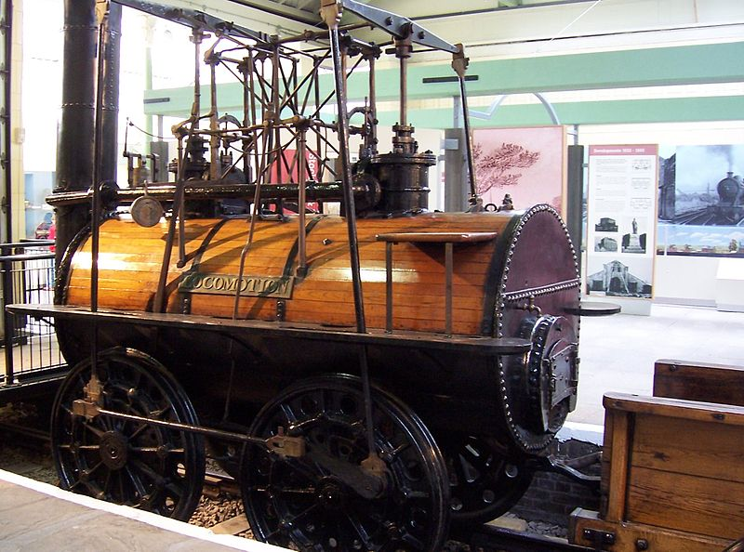
Origins of Standards – Railways
Historically, wagon wheel spacing was dictated by the width of two horses’ rear ends side-by-side, originally determined by Roman chariots
Original trains were designed to transport items similar to those towed by horses (also used same jigs and tools) → therefore sized the same
Railroad tracks required standardization to interchange railroad cars
Eventually the railroad industry in North America agreed on 4’ 8.5” similar to in England
Today’s railway track gauge therefore generally matches Romans’ adopted standardized gauge on their chariots
https://en.wikipedia.org/wiki/File:Locomotion_No._1..jpg
http://www.snopes.com/history/american/gauge.asp

Slide 9
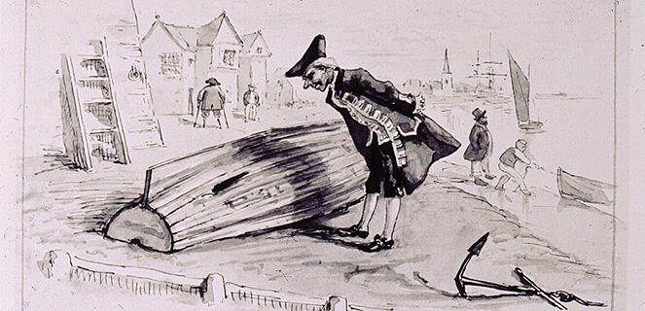
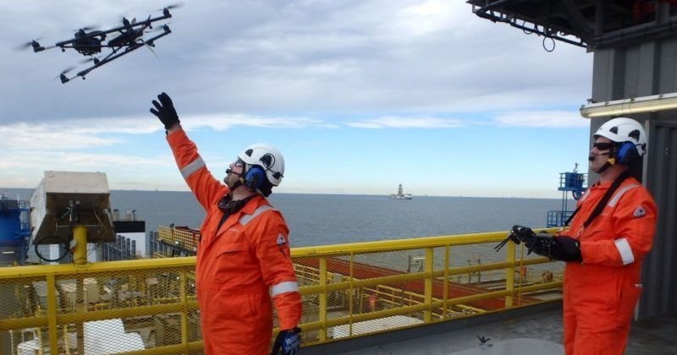
Origins of Standards – Lloyd’s Register
In 1760 London merchants, ship owners, and captains met at Edward Lloyd’s coffee house to make deals on sharing risks and rewards of voyages (“underwriting”) → origins of business insurance
Needed a way to classify a vessel’s condition, and required surveyors to assess ships
The Register Book listed the condition of classed vessel and subscriptions for the book paid for surveyors to do the work
This evolved to inspecting ships during construction, and classify ships if designed to published structural rules based on the size and use of the ship
Expanded to other industries and technologies
Expanded to other national “truth standards”
http://www.lr.org/en/about-us/our-heritage/brief-history/
https://safety4sea.com/lr-releases-guidance-note-for-drone-inspections/

Slide 10
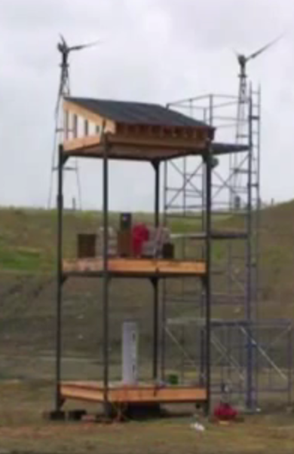
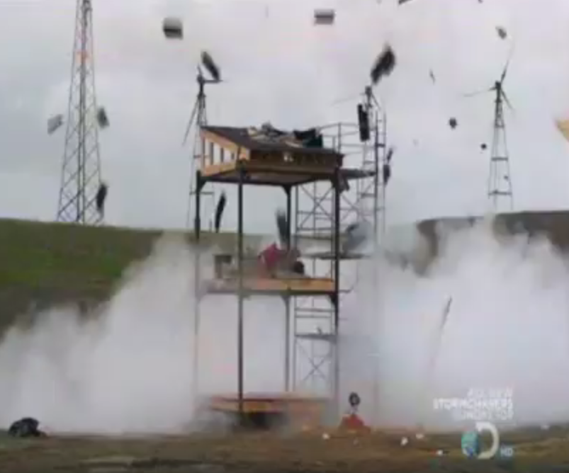
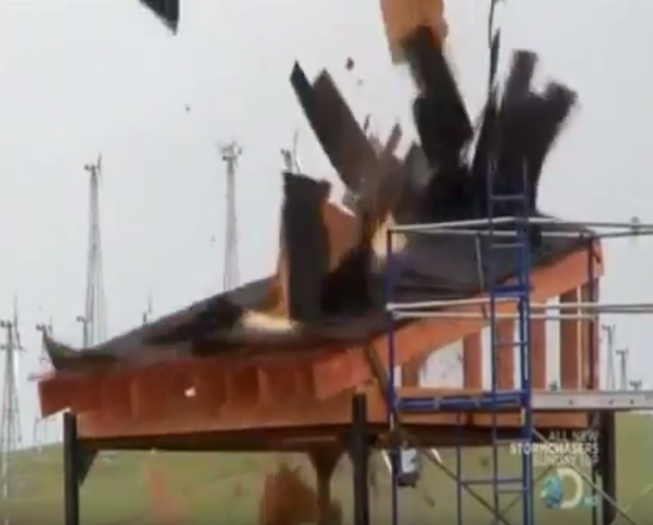
Origins of Standards -- ASME
American Society of Mechanical Engineers
Conceived in 1911 to provide public safety
Thousands of boiler explosions in late 1700s and 1800s after invention of the steam engine
Explosion at Grover Shoe Factory in Massachusetts killed 58 people and injured 117 (1905)
First book published in 1915 for Boilers and Pressure Vessels
600 documents today dealing with materials, examination, welding, nuclear equipment, etc.
https://www.asme.org/engineering-topics/articles/boilers/the-history-of-asmes-boiler-and-pressure Myth Busters: https://www.youtube.com/watch?v=28ixJLtQBCc (0-40sec ; 1:10; 2:05)

Slide 11
Standards / Certification / Codes / Regulations
Standards¹:
Rules and guidelines typically developed by volunteer committee members using a consensus-based approach
Generally require public consultation and provide feedback to comments
Are not mandatory → independent bodies use standards for certification, to create regulations, etc.
Certification²
The confirmation of certain characteristics of an object, person, or organization typically through some sort of external review, assessment, or audit
Some standards organizations will have Conformity Assessment Boards that create certification schemes for industries or national organizations to adopt
Codes³:
A requirement adopted by a government body (e.g adopted standards to be followed)
Have the force of law
Regulations⁴: rules or statutory requirements (including adopted standards and codes) of a government body
(1) https://www.iso.org/certification.html (2) https://en.wikipedia.org/wiki/Certification (3) ASME (4) Ostafichuk, P. Mech 328

Slide 12


Who’s Who in Canada
Standards Council of Canada (SCC)
Crown Corporation (est. 1970) to promote standardization in Canada
Leads development & use of national and international standards to enhance Canada’s competitiveness and well-being
Facilitates Canadian participation in ISO and IEC
Provides accreditation to certification organizations
Canadian Standards Association (CSA) (est. 1919)
Accredited by SCC as a standards development and certification body
Provides certification and testing services
Can work with companies to certify products, guide development
Variety of certification types and processes
https://www.scc.ca/en/about-scc/history http://www.csagroup.org/service/certification/

Slide 13

Similarly, in the USA
American National Standards Institute (ANSI)
Founded in 1918 by five engineering societies and three government agencies
Private, non-profit membership organization supported by private and public sector organizations
The U.S. member of ISO and IEC
Only accreditor of US voluntary consensus standards-developing organizations
Has program for accrediting 3rd party product certification
https://www.ansi.org/about_ansi/introduction/introduction?menuid=1

Slide 14
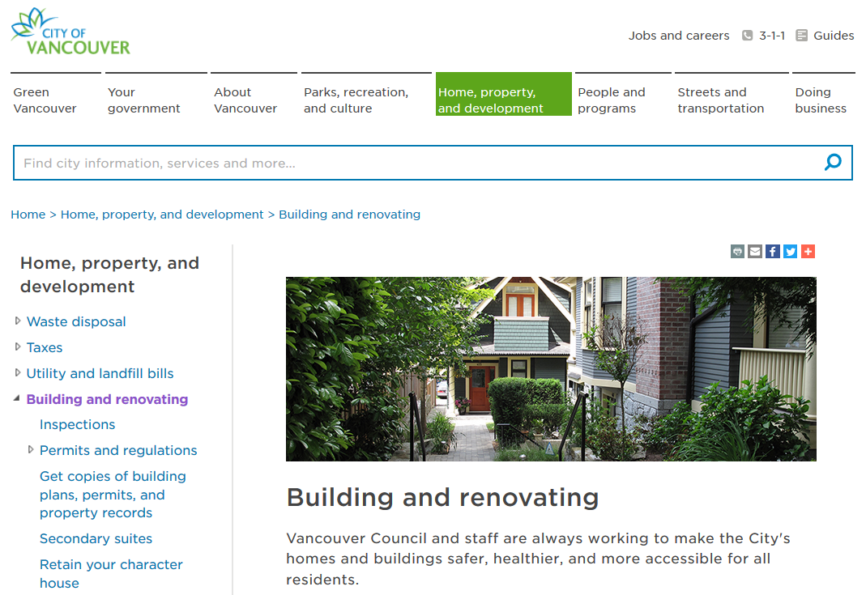
Regulatory Agencies
Use codes and standards to set minimum performance limits
May require adherence by law
Typically reference existing standards
May use 3rd party for testing and approvals
May be responsible for investigation, inspection, and enforcement
Ostafichuk, P. Mech 328
https://vancouver.ca/home-property-development/building-and-renovating.aspx

Slide 15
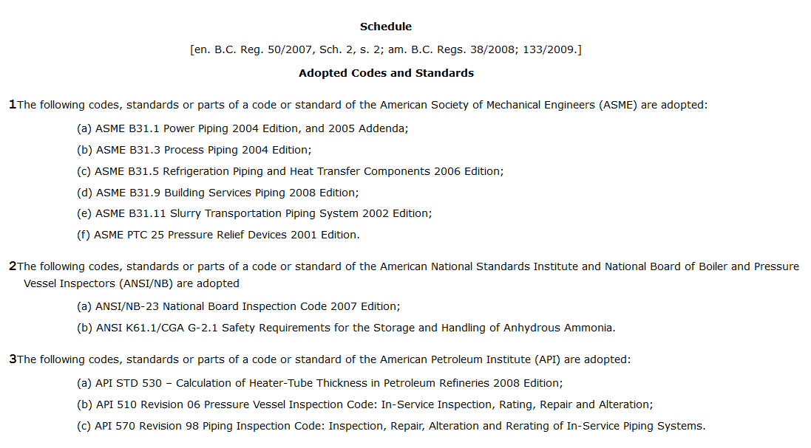
Regulatory Agencies
Excerpt from B.C. Reg. 104/2004: Power Engineers, Boiler, Pressure Vessel and Refrigeration Safety Regulation:
Ostafichuk, P. Mech 328

Slide 16
Progress Update
Why and from where?
Standards / Certification / Codes / Regulations
Who’s who in North America
Example standards organizations
Benefits of standards
Challenges to be aware of
How can we use them
Summary
How does this help me over the next 6 weeks?
Notes:
Acknowledge it may get a bit dry in the middle – due to both the factd that

Slide 17
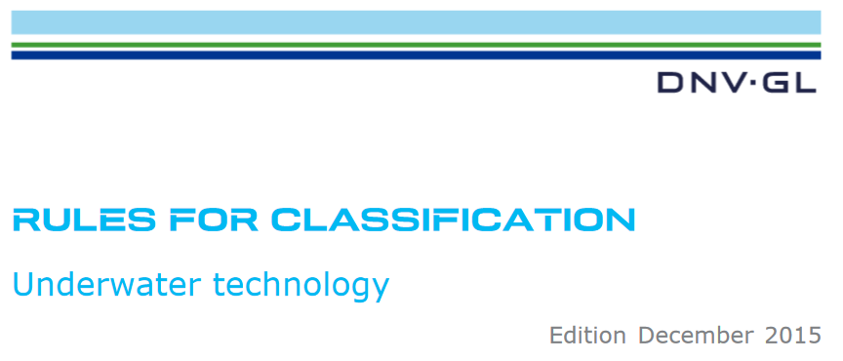
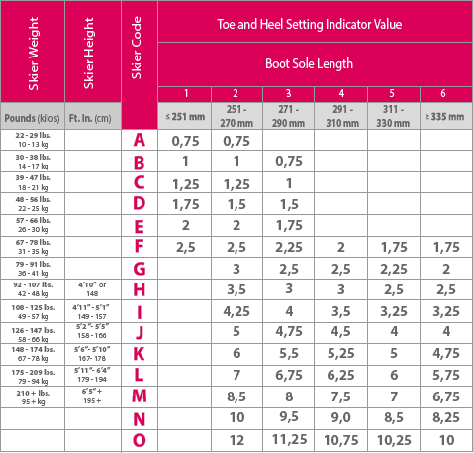
Example Standards Organizations
IEC (International Electrotechnical Commission)
ISO (International Organization for Standardization)
ASTM (American Society for Testing Materials)
CSA (Canadian Standards Association)
DIN (transl. German Institute for Standardisation)
NEMA (National Electrical Manufacturers Association)
MIL–STD (US Military Standard)
JETEC (Joint Electron Tube Engineering Council)
ASME (American Society of Mechanical Engineers)
CTA (Consumer Technology Association)
BSI (British Standard Institution)
API (American Petroleum Institute)
AFNOR (transl. French Association for Standardization)
SAE (Society of Automotive Engineers
AISC (American Institute of Steel Construction)
IEEE (Institute of Electrical and Electronics Engineers)
Bureau Veritas (Certification agency based in France)
DNV GL (Registrar and classification society based in Norway)
https://rules.dnvgl.com/docs/pdf/DNVGL/RU-UWT/2015-12/DNVGL-RU-UWT-Pt5Ch7.pdf
DIN Settings Table
http://www.dincalculator.com/#/

Slide 18
Some Example Standards
Common types of standards¹
Classification systems: systematic arrangement or division
Specifications: set of requirements
Terminology: definitions
Test method: definitive procedure to produce a test result
Practice: definitive instructions
Guide: informational description but does not recommend a course of action
Examples:
CSA CAN3-B78.1-M83 (R2002): Technical drawing standard
ISO 9000: Process quality management and control
ISO 14000²: Tools for organizations to manage their environmental responsibilities (processes, lifecycle analysis, etc.)
IEEE N42.44-2008: Cabinet X-ray imaging performance implemented post 9/11³
Government of Canada – Recognized Standards for Medical Devices https://www.canada.ca/en/health-canada/services/drugs-health-products/medical-devices/standards/list-recognized-standards-medical-devices-draft-guidance.html
1 Adapted from ASTM International / Definitions and Sample Standards
2 https://www.iso.org/iso-14001-environmental-management.html 3 https://standardsboostbusiness.org/case-innovation.aspx

Slide 19
Benefits of Standards
So, why all this effort again?
Improve safety based on recognized process and component requirements
Reduce risks around time/cost/performance for financing and insurance
Save money and time with interchangeability, uniformity, improved quality and “not reinventing the wheel”
Identify issues that might not have been considered otherwise
Access larger markets to due internationally accepted rules and guidelines
Enhanced communication due to standardized terms and communication methods
Easier to evaluate and benchmark based on existing values and processes

Slide 20
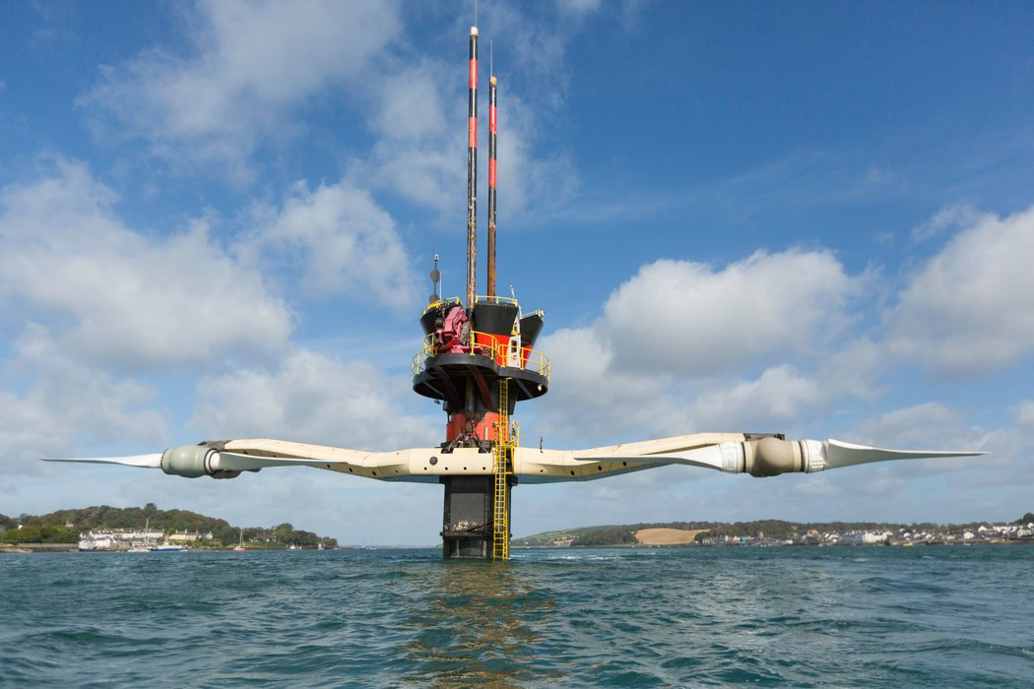
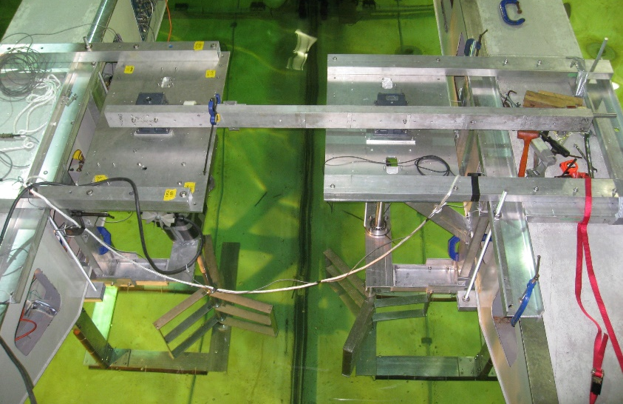
Benefits – What do companies gain?
Opportunity to influence domestic and international policy
Access to potential markets
A forum to present national and/or corporate positions
Unique networking opportunities and to learn from international colleagues
20 ft
3 ft
https://www.nytimes.com/2014/04/03/business/energy-environment/going-under-the-sea-for-clean-energy.html
IEC – US National Committee support brochure
https://share.ansi.org/Shared%20Documents/Standards%20Activities/International%20Standardization/IEC/USNC%20Tool%20Box/USNC_company_support_brochure.pdf

Slide 21
Challenges with Standards
Loss of ingenuity and creativity → jump straight to standard
Might not cover your specific situation
Might be a hidden cost to due to built-in safety factors (overly conservative)
Might change, be out-of-date, or not match state-of-the art
Lag behind new technologies
Impede adoptions of improved technologies or processes
Must first change standard or certification process
Resistance from established companies, industry, or lobby
May be driven to use more expensive or inconvenient equipment or procedures if preferred items are not approved
Ostafichuk, P. Mech 328

Slide 22
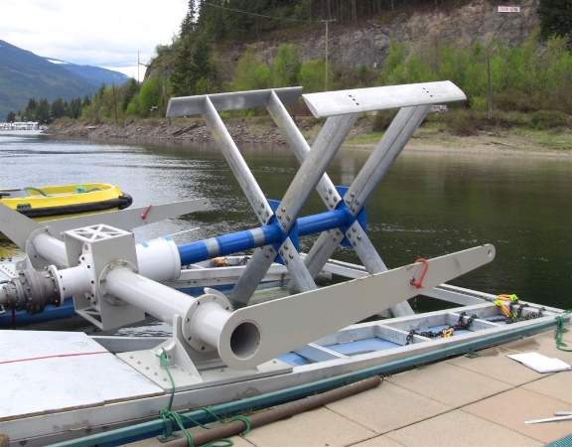
Challenges with Standards -- Examples
ISO standards where recommended business standards don’t work well with some businesses
Marine renewables – lack of certification for submarine cables
http://www.newenergycorp.ca/encurrent-025-series.html

Slide 23
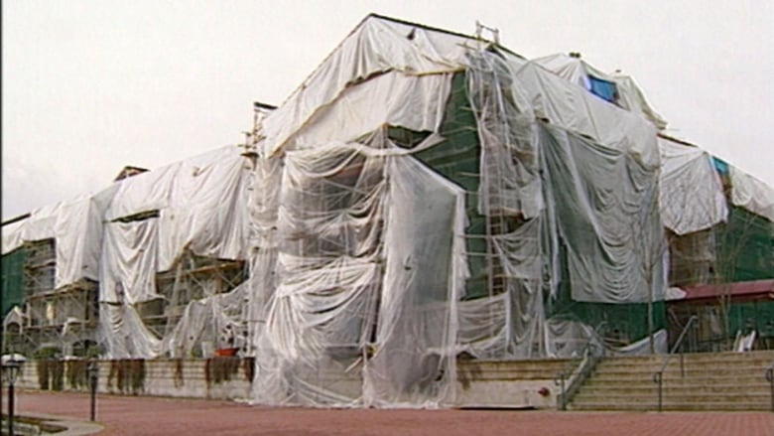
Challenges with Codes: Unintended Consequences
Leaky condo crisis in B.C. estimated cost $3-5 billion
Multiple reasons including:
Inappropriate design features and building materials
Changes in building codes which permitted/encouraged unsuitable design and construction
Fundamental lack of awareness re: principles of enclosure design suitable for the Lower Mainland climate
Lack of meaningful inspection at critical stages of construction
An inadequate regulatory system and warranty program
https://vancouversun.com/news/staff-blogs/leaky-condo-crisis-far-from-over https://www.cbc.ca/news/canada/british-columbia/bc-leaky-condo-crisis-1.4609418
https://www.millerthomson.com/assets/files/article_attachments/KLW_2016-02_Water-Ingress.PDF
British Columbia, Commission of Inquiry into the Quality of Condominium Construction in British Columbia, The Renewal of Trust in Residential Construction, (Victoria: Government of British Columbia, 1998) at Chapter One, II. What Has Gone Wrong[the“Barrett Commission”].

Slide 24
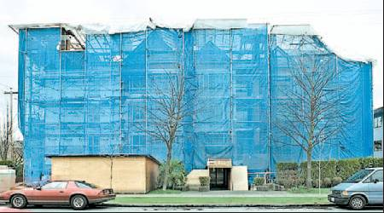
Challenges with Codes: Unintended Consequences
The BC Building Code mirrored National Building Code of Canada → through 1970s and 1980s progressively required greater sealing of exterior walls to prevent moisture infiltrating the building
Works in dryer regions but prevented walls from breathing and drying out in our climate
Leads to rot & mould
In 1980s Vancouver by-law change began to include roof overhang in floor space ratio calculation (% of lot space occupied by a building)
→ Encouraged the removal of roof overhangs from design to maximize useable indoor space making buildings more susceptible to leaks
https://www.millerthomson.com/assets/files/article_attachments/KLW_2016-02_Water-Ingress.PDF Barrett Commission, supra note 6 at Chapter Two, II.
Image: http://www.joshmulherin.com/blog/2017/05/20/leaky-condo-crisis-rears-its-head-again-in-b-c/

Slide 25
How might you use standards?
A few ways I’ve used standards early in my career:
Apply them directly
Ship design requirements (same will go for those in other sectors e.g. medical devices, electronic devices, power generation, mechanical and structural design)
Adapt existing standards
Took design rules from one industry and applied to renewable energy industry
e.g. fatigue loading on welded connections, beam buckling assessment
Confirm “state-of-the-art” to make sure I’m not being negligent
Inform equipment specification, selection and design
IP Ratings for instrumentation protection from dust and water ingress
Mooring system safety factors

Slide 26
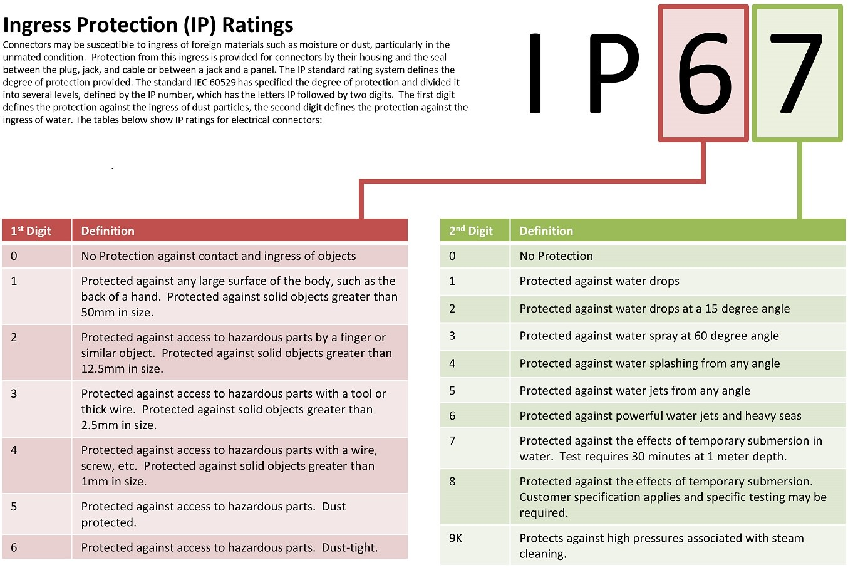
How might you use standards?
Solids | Liquids
IP Code: International Protection Marking (IEC Std. 60529)
Rates the degree of protection provided against intrusion for solids and liquids.
http://www.greatsoftline.com/mi5-the-upcoming-flagship-smartphone-from-xiaomi/

Slide 27
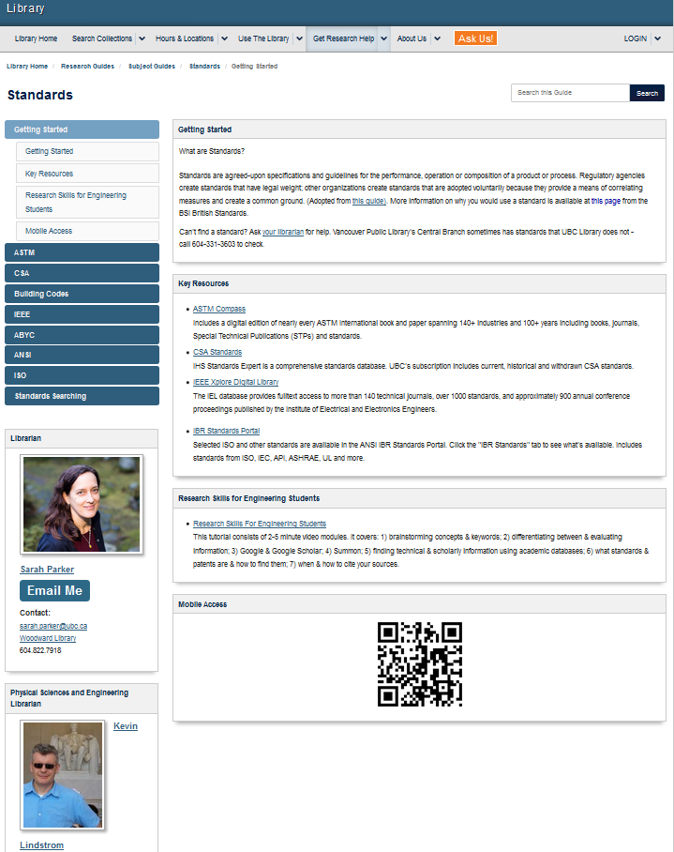
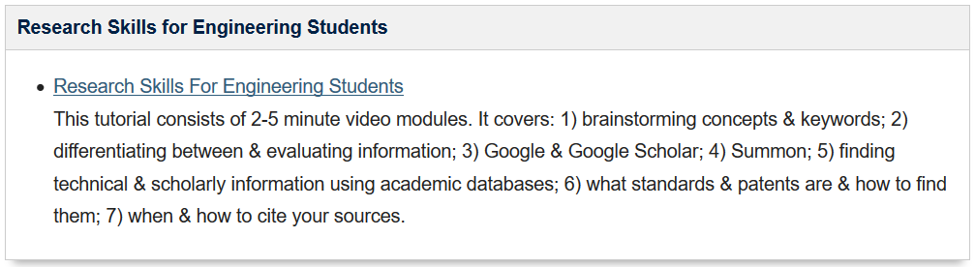
Access to Standards
Standards are not free (typically developed by non-profits but fund operations)
Can generally browse portions of standards on-line (scope, ToC, etc.)
https://webstore.iec.ch/
https://www.iso.org/standards-catalogue/browse-by-ics.html
UBC provides access to select standards for academic purposes
http://guides.library.ubc.ca/c.php?g=307008&p=2048248
Notes:
Sarah and Kevin

Slide 28
To Review….
Standards:
Codes:
Certification:
Regulations:
SCC vs CSA:
Benefits of Standards:
Challenges with Standards & Codes:

Slide 29
In-Class Exercise
Too much of my life is currently being consumed by Mech328 – how can all of this help with that?
The project materials (and proper design process) require us to consider standards, codes of practice, and legal and regulatory factors as part of our engineering work with respect to:
Requirements
Health and safety
User manuals (including warnings)
Must also consider cost and duration of remaining development effort (including procedures testing prototypes)
Notes:
Your project assignment requires that you consider standards as part of your design –
Might as well work together since we have a lot of googling powerin our class of about 120 people.
I figured we could work together to tackle some of the common challenges to the groups

Slide 30
In-Class Exercise
Look up standards related to:
Materials & design requirements
Testing requirements
Operating requirements
Sampling requirements
Identify specific organizations, standards, and technical committees by name and number where possible.
Collaborate using google sheets: https://tinyurl.com/Mech328-Standards
Teams | Topic
1 - 4 | People-Carriers: Wheelchairs / Stretchers / Gurneys / etc.
5 - 8 | Trail Conditions / Road Roughness / Hill Climbing
9 - 12 | Electrical motors, sensors, batteries
13 - 15 | Propulsion equipment standards (thrusters, engines, propellers, etc.)
16 - 18 | Mechanical components (e.g. bearings, gears, couplings, belt drives, etc.) and materials
19 - 21 | Environmental protection (resist the elements) and resistance to impact & motion loading

Slide 31
In-Class Exercise
IEC (International Electrotechnical Commission)
ISO (International Organization for Standardization)
ASTM (American Society for Testing Materials)
CSA (Canadian Standards Association)
DIN (transl. German Institute for Standardisation)
Bureau Veritas Group
NEMA (National Electrical Manufacturers Association)
MIL – STD (US Military Standard)
JETEC (Joint Electron Tube Engineering Council)
ASME (American Society of Mechanical Engineers)
CTA (Consumer Technology Association)
SAE (Society of Automotive Engineers)
DNV GL
Can also look up test labs such as:
CSA
Halthass.co.nz
Desolutions.com
http://labtestcert.com
Teams | Topic
1 - 4 | People-Carriers: Wheelchairs / Stretchers / Gurneys / etc.
5 - 8 | Trail Conditions / Road Roughness / Hill Climbing
9 - 12 | Electrical motors, sensors, batteries
13 - 15 | Propulsion equipment standards (thrusters, engines, propellers, etc.)
16 - 18 | Mechanical components (e.g. bearings, gears, couplings, belt drives, etc.) and materials
19 - 21 | Environmental protection (resist the elements) and resistance to impact & motion loading

Slide 32
Teams 1-4: People-Carrier standards

Slide 33
Teams 5-8: Trail Condition Standards

Slide 34
Teams 9-12: Electrical motors / components / batteries

Slide 35
Teams 13-15: Propulsion equipment standards

Slide 36
Teams 16-18: Mechanical components and materials

Slide 37
Teams 19-21: Environmental protection and impact loading

